Slide 1
INTRODUCTION
Nutrition may be defined as the science of food and its relationship to health. It is concerned primarily with the part played by nutrients in body growth, development and maintenance .
The word nutrient or “food factor” is used for specific dietary constituents such as proteins, vitamins and minerals. Dietetics is the practical application of the principles of nutrition; it includes the planning of meals for the well and the sick. Good nutrition means “maintaining a nutritional status that enables us to grow well and enjoy good health.”

Slide 2
Protein, carbohydrate and fat had been recognized early in the 19th century as energy-yielding foods and much attention was paid to their metabolism and contribution to energy requirements.

Slide 3
CLASSIFICATION OF FOODS
Classification by origin:
- Foods of animal origin
  - Foods of vegetable origin
Classification by chemical composition:
- Proteins
  Fats
  Carbohydrates
  Vitamins
  Minerals

Slide 4
CLASSIFICATION BY PREDOMINANT FUNCTION
Body building foods:
-meat, milk, poultry, fish, eggs, pulses etc
Energy giving foods:
-cereals, sugars, fats, oils etc.
Protective foods:
-vegetables, fruits, milk, etc

Slide 5
NUTRIENTS
Organic and inorganic complexes contained in food are called nutrients. They are broadly divided in to:
Macronutrients:
-proteins
-fats
-carbohydrates
Micronutrients:
-vitamins
-minerals

Slide 6
Carbohydrate
A carbohydrate is a large biological molecule, or macromolecule, consisting of carbon (C), hydrogen (H), and oxygen (O) atoms, usually with a hydrogen: oxygen atom ratio of 2:1 (as in water); in other words, with the empirical formula C_{m}(H₂O)_{n} (where m could be different from n). EX D-Glucose C₆H₁₂O₆
For example, deoxyribose, a sugar component of DNA, has the empirical formula C₅H₁₀O₄.

Slide 7
Four chemical groups:
Monosaccharides: are the simplest carbohydrates in that they cannot be hydrolyzed to smaller carbohydrates. Examples: glucose and fructose.
Disaccharides: two joined monosaccharides are called a disaccharide and these are the simplest polysaccharides. Examples: Lactose, a disaccharide composed of one D-galactose molecule and one D-glucose molecule, The systematic name for lactose is O-β-D-galactopyranosyl-(1→4)-D-glucopyranose.
Oligosaccharide: is a saccharide polymer containing a small number (typically three to nine[) of simple sugars (mono saccharides). Ex: Fructo-oligosaccharides, Galacto-oligosaccharides etc.
Polysaccharides: serve for the storage of energy (e.g., starch and glycogen), and as structural components (e.g., cellulose in plants and chitin in arthropods).

Slide 8
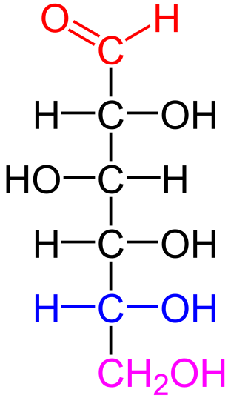
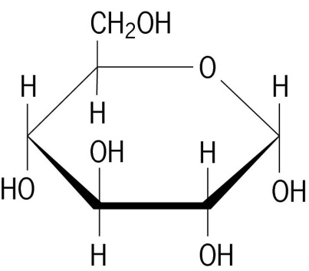
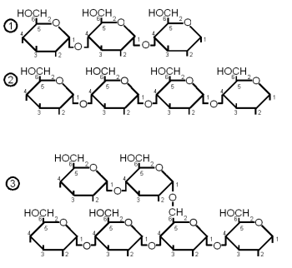
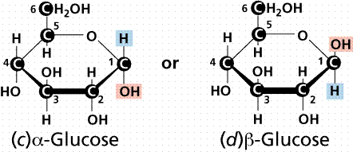
D-Glucose in ring form
D-Glucose
Oligosaccharide in ring form

Slide 9
What happens if we don’t get enough carbohydrate?
Eating too little carbohydrate may lead to low blood sugar levels – called ‘hypoglycaemia’, leaving you feeling weak and light headed.
It can also affect concentration as your brain needs a good supply of fuel to think and learn. Hypoglycaemia is a particular risk for people with diabetes and very active sports People.
If we eat too little carbohydrate our body will begin to use up some stored fat but quickly moves on to burning protein tissue such as in the heart and muscles.

Slide 10
How are carbohydrates used for energy?
We break down most carbohydrates in the gut and absorb them into our blood stream as their individual sugar units. Simple carbohydrates usually digest
quickly giving a rapid rise in blood sugar. Complex carbohydrates take longer to break down into their individual sugar units before they can be absorbed,
resulting in a slower rise in our blood sugar levels.
Sugar in the blood is carried into cells such as the muscles and brain with the help of the hormone insulin. We convert any sugar the cells do not need immediately from glucose to glycogen and store it in the liver and muscles for use at a later date. When the stores are full we covert any excess to body fat.

Slide 11
How much carbohydrate should we eat?
Half of our energy intake should come from carbohydrate; we should aim to make ‘starchy’ carbohydrates the base and bulk for each meal and snack.
Starchy foods are a good source of energy and fibre and also contain calcium, iron and B vitamins. Choose wholegrain starchy foods as they contain more nutrients.
Sugary foods and drinks generally do not contain many other nutrients so have them occasionally in small amounts, preferably after a fiber rich meal.

Slide 12
Aren’t carbohydrates fattening?
We get energy from carbohydrates, protein, fat and alcohol in our diet.
Any extra (unneeded) energy we take in will be converted to fat no matter what the source.
Sometimes people think starchy foods are fattening however, the same amount (in weight) of carbohydrate contains less than half the calories of fat.
Studies have also shown carbohydrates are better at satisfying our hunger.

Slide 13
CARBOHYDRATE
Carbohydrate is the main source of energy, providing 4 Kcals per one gram Carbohydrate is also essential for the oxidation of fats and for the synthesis of certain non-essential amino acids

Slide 14
Sources of carbohydrates
There are three main sources of carbohydrate, viz. starches, sugar and cellulose.
The carbohydrate reserve (glycogen) of a human adult is about 500g. This reserve is rapidly exhausted when a man is fasting. If the dietary carbohydrates do not meet the energy needs of the body, protein and glycerol from dietary and endogenous sources are used by the body to maintain glucose homeostasis.

Slide 15
Can ‘low-carbohydrate’ diets help with weight loss?
‘Low-carbohydrate’ diets are sometimes used for weight loss. In the short term they can lead to side effects such as constipation, headache, bad breath and nausea.
In the longer term, cutting out any food group can be bad for health because you risk missing out on vital nutrients.
Low-carbohydrate diets tend to be high in fat.
Eating a high-fat diet (especially one rich in saturated fat from foods such as meat, cheese, cream and butter) could increase the chances of developing heart disease.
Low -carbohydrate diets may also restrict the amount of fruit, vegetables and fibre, all of which are vital for good health, including reducing cancer risk.
There is more research needed into how safe or effective low-carbohydrate diets are and following a low-carbohydrate diet does not seem to help people lose weight and keep it off.

Slide 16
What does the Glycaemic Index of carbohydrates mean?
Different carbohydrate containing foods are digested and absorbed at different rates. The Glycaemic Index (GI) is used to identify which carbohydrates are quickly broken down to glucose (high GI) and which are slowly broken down (low GI).
A food with a high GI (e.g white bread, crisps and carrots) will cause a fast rise in your blood sugar levels followed by a rapid fall.
A food with a low to moderate GI (e.g. wholemeal pasta, oats, beans and yoghurt) will cause a slower rise and fall.
GI is a well known dieting tool, however it can be restricting as it measures foods per 50g of carbohydrate provided and not by portion size, and so foods like carrots are included in the high GI list along with other important fruits and vegetables.

Slide 17
What about Glycaemic Load?
Glycaemic Load (GL) is a sum which takes into account the GI of a food and the available carbohydrate content in a serving of that food. Like Gl the higher the GL, the faster the expected rise in blood sugar.
For example, carrots have a high GI but a low GL. This is because GI is based on the rise caused by consuming 50g of carbohydrate from any food.
So to get 50g of carbohydrate from carrots you would need to eat around 700g of carrots– about five whole carrots to cause this blood sugar rise.
As a portion of carrots eaten is much smaller at 60g rather than 700g, carrots can be considered as having a low GL and therefore can be included in your diet.

Slide 18
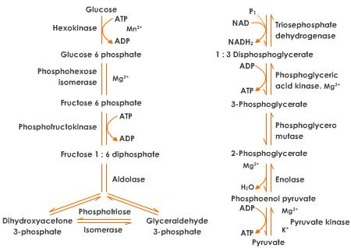
Glycolysis: Pathway of degradation

Slide 19
Summary
Carbohydrates are an important part of your diet and should make up half of each meal. Whenever possible choose wholegrain ‘starchy’ carbohydrates
As they contain additional important ‘nutrients’ for the body. Carbohydrates are a healthy filling choice; they are better at satisfying our hunger than fatty/sugary foods which also contain more calories.
So forget those myths about carbohydrates being bad and don’t be tempted to cut out those slow releasing carbohydrates.

Slide 20
Proteins
Protein is the main tissue builder and part of every cell in the body.
proteins help to: make hemoglobin in the blood that carries oxygen to the cells;
form anti-bodies that fight infection;
supply nitrogen for DNA and RNA genetic material;
and supply energy.

Slide 21
Proteins
Proteins are the short or long chain of amino acids.
Among the 20 or more amino acids, the human body is unable to synthesize 8, therefore, these amino acids are called essential amino acids.
A food containing protein may be of poor biological value if it is deficient in one or more of the 8 essential amino acids: lysine, tryptophan, methionine, leucine, isoleucine, phenylalanine, valine, and threonine.
Proteins of animal origin have the highest biological value because they contain a greater amount of the essential amino acids.
Foods with the best quality protein are listed in diminishing quality order: whole eggs, milk, soybeans, meats, vegetables, and grains.

Slide 22
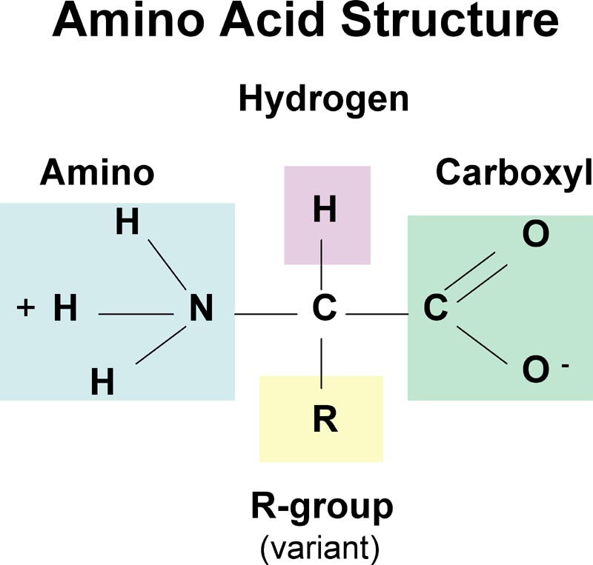
Research has shown that about 20% of a human body is made up of proteins.

Slide 23
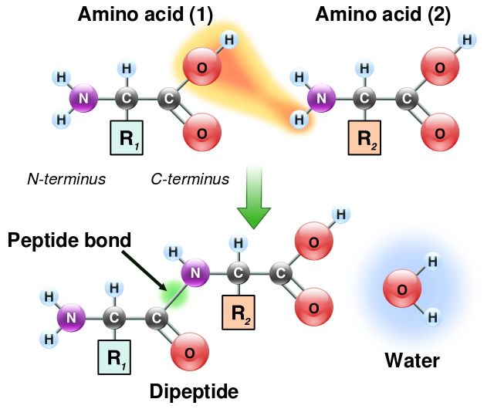

Slide 24
PROTEINS
Proteins are complex organic nitrogenous compounds.
They also contain sulfur and i some cases phosphorous and iron.
Proteins are made of monomers called amino acids.
There are about 20 different aminoacids which r found in human body.
Of this 8 aa are termed “essential” as they are not synthesized in human body and must be obtained from dietary protiens.

Slide 25
Functions of Proteins
Body building
Repair and maintenance of body tissues
Maintenance of osmotic pressure
Synthesis of bioactive substances and other vital molecules

Slide 26
Evaluation of proteins
The parameters used for net protein evaluation are:
Biological value
Digestibility coefficient
Protein efficiency ratio
Net protein utilization (NPU)

Slide 27
Assessment of Protein nutrition status
Protein nutrition status is measured by Serum Albumin Concentration.
It should be more than 3.5 g/dl.
Less than 3.5 g/dl shows mild malnutrition.
Less than 3.0 g/dl shows severe malnutrition.

Slide 28
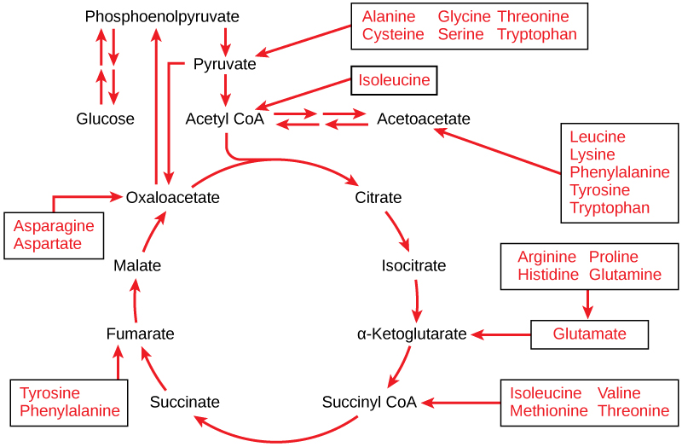
The carbon skeletons of certain amino acids (indicated in boxes) derived from proteins can feed into the citric acid cycle. (credit: modification of work by Mikael Häggström)

Slide 29
Fats/Lipids
Fats are concentrated sources of energy because they give twice as much energy as either carbohydrates or protein on a weight basis.
The functions of fats are to: make up part of the structure of cells, form a protective cushion and heat insulation around vital organs, carry fat soluble vitamins, and provide a reserve storage for energy.
Three unsaturated fatty acids which are essential include: linoleic, linolinic, and arachidonic and have 2, 3, and 4 double bonds respectively.
Saturated fats, along with cholesterol, have been implicated in arteriosclerosis, "hardening of the arteries".
For this reason, the diet should be decreased in saturated fats (animal) and increased in unsaturated fat (vegetable).

Slide 30
FAT
Most of the body fat (99 per cent) in the adipose tissue is in the form of triglycerides, in normal human subjects, adipose tissue constitutes between 10 and 15 per cent of body weight. One kilogram of adipose tissue corresponds to 7700 kcal of energy.
Most of the body fat (99 per

Slide 31
Fats yield fatty acids and glycerol on hydrolysis
Fatty acid content of different fats ( in per cent)
Saturated Monounsaturated Polyunsaturated
Fats fatty acids fatty acids fatty acids
Coconut oil 92 6 2
Palm oil 46 44 10
Cotton seed oil 25 25 50
Groundnut oil 19 50 31
Safflower oil 10 15 75
Sunflower oil 8 27 65
Corn oil 8 27 65
Soya bean oil 14 24 62
Butter 60 37 3

Slide 32
Essential fatty acids are those that cannot be synthesized by humans
Dietary sources of EFA
Linoleic acid
Sunflower oil Corn oil Soya bean oil Sesame oil Groundnut oil Mustard oil Palm oil Coconut oil
Arachidonic acid
Meat, eggs, milk
Linolenic acid
Soya bean oil, Leafy greens

Slide 33
Functions of fats
They are high energy foods, providing as much as 9 kcal for every gram.
Fats serve as vehicles for fat-soluble vitamins
Fats in the body support viscera such as heart, kidney and intestine; and fat beneath the skin provides insulation against cold.

Slide 34
The “non-calorie” roles of fat
vegetable fats are rich sources of essential fatty acids which are needed by the body for growth, structural integrity of the cell membrane and decreased platelet adhesiveness.
Diets rich in EFA have been reported to reduce serum cholesterol and low-density lipoproteins.
Polyunsaturated fatty acids are precursors of prostaglandins.

Slide 35
Fat requirements
In developed countries dietary fats provide 30 to 40 per cent of total energy intake. The WHO Expert committee on Prevention of Coronary Heart Disease has recommended only 20 to 30 per cent of total dietary energy to be provided by fats. At least 50 per cent of fat intake should consist of vegetable oils rich in essential fatty acids.

Slide 36
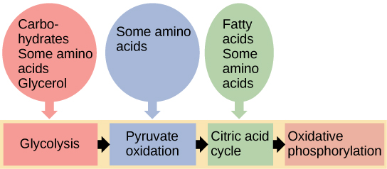
Glycogen from the liver and muscles, hydrolyzed into glucose-1-phosphate, together with fats and proteins, can feed into the catabolic pathways for carbohydrates

Slide 37
Minerals
Minerals:
The minerals in foods do not contribute directly to energy needs but are important as body regulators and as essential constituents in many vital substances within the body.
A MINERAL is rather loosely defined as any element not normally a part of the structures of carbohydrates, proteins, and fats. More than 50 elements are found in the human body.
About 25 elements have been found to be essential, since a deficiency produces specific deficiency symptoms.
Major Minerals Include: calcium, phosphorus, iron, sodium, potassium, and chloride ions.
Other Essential Minerals Include: copper, cobalt, manganese, zinc, magnesium, fluorine, and iodine.

Slide 38
The recommended daily requirements of minerals for men, women are shown in the table below
Minerals | Men | Women | Sources
Calcium | 700mg | 700mg | milk, cheese and other dairy foods green leafy vegetables, such as broccoli, cabbage and okra, but not spinach, soya beans, tofu, soya drinks with added calcium, nuts, bread and anything made with fortified flour, fish where you eat the bones, such as sardines and pilchards
Iodine | 0.14mg | 0.14mg | sea fish and shellfish, cereals, grains
Iron | 8.7mg | 14.8mg | liver, meat, beans, nuts, dried fruit, such as dried apricots, wholegrains, such as brown rice, fortified breakfast cereals, soybean flour, most dark-green leafy vegetables, such as watercress and curly kale
Beta-carotene | 7mg | 7mg | yellow and green (leafy) vegetables, such as spinach, carrots and red peppers, yellow fruit such as mango, melon and apricots
Boron | <6mg | <6mg | green vegetables, fruit, nuts
Chromium | 0.025mg | 0.025mg | meat, wholegrains, such as wholemeal bread and whole oats, lentils, spices
Cobalt | 0.0015mg | 0.0015mg | fish, nuts, green leafy vegetables, such as broccoli and spinach, cereals, such as oats
Copper | 1.2mg | 1.2mg | nuts, shellfish, offal
Magnesium | 300mg | 270mg | nuts, spinach, bread, fish, meat, dairy foods
Manganese | <0.5mg | <0.5mg | tea, bread, nuts, cereals, green vegetables such as peas and runner beans
Phosphorus | 550mg | 550mg | red meat, dairy foods, fish, poultry, bread, rice, oats
Potassium | 3,500mg | 3,500mg | fruit such as bananas, vegetables, pulses, nuts and seeds, milk, fish, shellfish, beef, chicken, turkey, bread
Selenium | 0.075mg | 0.06mg | brazil nuts, bread, fish, meat, eggs
Sodium chloride (salt) | <6g | <6g | ready meals, meat products, such as bacon, some breakfast cereals, cheese, some tinned vegetables, some bread, savoury snacks
Zinc | 9mg | 7mg | meat, shellfish, milk, dairy foods, such as cheese, bread, cereal products, such as wheat germ.

Slide 39

Water
A healthy adult living in a temperate climate should drink 1.5 litres of water per day.
This threshold of drinking water enables to balance water losses and keep one’s body properly hydrated.
Water is a major constituent of our bodies and vital organs.

Slide 40
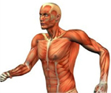
The 5 functions of water in our body body-water
2. Chemical and metabolic reactions: Water removes waste products including toxins that the organs’ cells reject, and removes them through urines and faeces.
1. Cell life: Water is a carrier, distributing essential nutrients to cells, such as minerals, vitamins and glucose
3. Transport of nutrients: Water participates in the biochemical break-down of what we eat.
4. Body temperature regulation: Water has a large heat capacity which helps limit changes in body temperature in a warm or a cold environment.
Water allows the body to release heat when ambient temperature is higher than body temperature.
5. Elimination of waste: Water is an effective lubricant around joints. It also acts as a shock absorber for eyes, brain, spinal cord and even for the foetus through amniotic fluid.

Slide 41
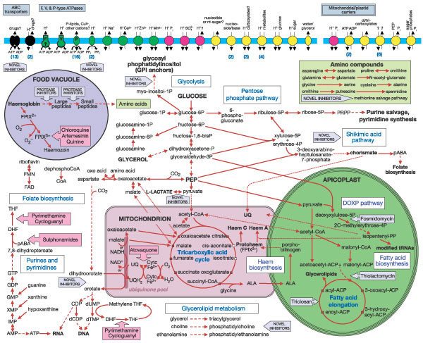

Slide 42
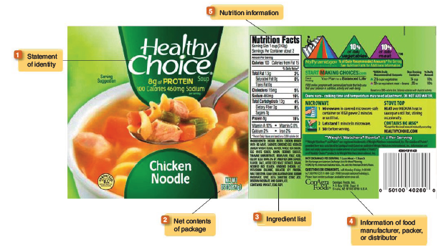
Food Labels
The FDA requires food labels on most products.
These labels must include

Slide 43
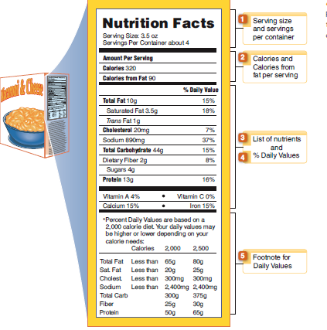
Nutrition Facts Panel
The Nutrition Facts Panel contain the nutrition information required by the FDA.
This information can be used in planning a healthful diet.

Slide 44
Dietary Guidelines
Nutrition recommendations for Canada and the United Kingdom
  General guidelines for a healthful diet
  Similar to Dietary Guidelines for Americans

Slide 45
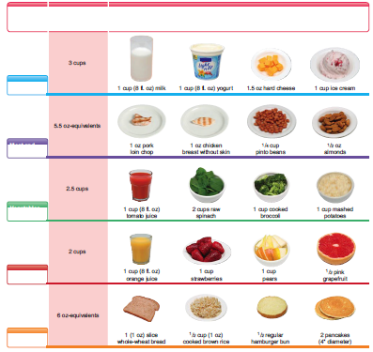
MyPyramid

Slide 46
  THE END

